Slide 1
Object-Oriented Programming
WEEK 03 Abeeha Sattar

Slide 2
What about Structs in Java?
Java does not support structs!
So we don’t need to worry about it : D
There is a roundabout way of using them
By using external libraries (JUnion)
Notes:
int main() {
Car c;
c.turn(‘l’);
}

Slide 3
Constructors
A constructor is a member function of a class that has the same name as the class.
Constructors are used to initialize objects.
A constructor must have the same name as the class of which it is a member.

Slide 4
How are constructors different from member functions?
They have the same name as the class
They don’t have a return type
They are called when you create a new class object
Compilers usually create a default constructor if we haven’t declared any constructors
Notes:
If we end up making any parameterized or copy constructor then its necessary to make a default constructor ourselves.
Otherwise this might lead to errors.

Slide 5
Types of Constructors
Default Constructor
A constructor without any arguments (aka, without any parameters)
Parameterized Constructor
A constructor that can accept arguments/parameters
The parameters are used to initialize the object
Copy Constructor
A constructor that initializes an object by using another object of the same class
It copies the values from the other object

Slide 6

Default Constructor – if not declared…
class BankAccount {
private double balance;
private double interest_rate;
}
public static void main(String[] args) {
BankAccount ba01 = new BankAccount();
System.out.println("Executed Successfully...");
}

Slide 7
Default Constructor – User Defined
class BankAccount {
private double balance;
private double interest_rate;
//assume getters and setters are here
BankAccount() { //default constructor
System.out.println("Default Constructor called successfully.");
}
}

Slide 8

Default Constructor – User Defined
public static void main(String[] args) {
BankAccount ba01 = new BankAccount();
System.out.println("Executed Successfully...");
}

Slide 9
Default Constructor
Compilers provide a default constructor implicitly
You may not see it, but they exist!!!
A constructor is necessary to create an object!
What happens if you make a constructor private?

Slide 10
What happens if you make a constructor private?
class BankAccount {
private double balance;
private double interest_rate;
//assume getters and setters are here
private BankAccount() { //default constructor
System.out.println("Default Constructor called successfully.");
}
}

Slide 11

What happens if you make a constructor private?
public static void main(String[] args) {
BankAccount ba01 = new BankAccount();
System.out.println("Executed Successfully...");
}

Slide 12
Parameterized Constructor
When an object is declared using a parameterized constructor, the initial values have to be passed as arguments to the constructor function
There can be multiple constructors in a class – This is Constructor Overloading
There can be multiple parameterized ones as well!

Slide 13
Parameterized Constructor
class BankAccount {
private double balance;
private double interest_rate;
//assume getters and setters are here
private BankAccount() { //default constructor
System.out.println("Default Constructor called successfully.");
}
BankAccount(double _balance) { //parameterized constructor
this.balance = _balance;
interest_rate = 0.19;
System.out.println("Parameterized Constructor (1 arg) called successfully.");
}
BankAccount(double _balance, double _interest_rate) { //parameterized constructor
this.balance = _balance;
interest_rate = _interest_rate;
System.out.println("Parameterized Constructor (2 args) called successfully.");
}
}
Parameterized Constructors

Slide 14
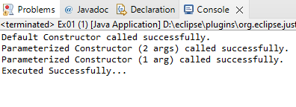
Parameterized Constructor – How to Use
public static void main(String[] args) {
BankAccount ba01 = new BankAccount(); //default constructor
BankAccount ba02 = new BankAccount(2000.01,0.02); //parameterized constructor
BankAccount ba03 = new BankAccount(99.99); //parameterized constructor
System.out.println("Executed Successfully...");
}

Slide 15
Constructor Overloading in Java
Just like normal member functions, constructors can be overloaded as well!
We’ve already seen this being done in our previous example
Default Constructor: BankAccount()
Parameterized Constructor: BankAccount(double _balance, double _interest_rate)
See how they have the same names but different arguments?
You can have many overloaded constructors as long as they have a different parameter list!

Slide 16
Copy Constructor
A copy constructor is a member function which initializes an object using another object of the same class.
It follows this prototype:
ClassName (ClassName obj_to_be_copied);
Notes:
Over here we’re using const because we’re receiving a reference to the object.
If we accidentally make any changes to the object here, it would be reflected onto the real object!
We can prevent that by using const

Slide 17
Copy Constructor
The copy constructor for our class would look like this:
BankAccount( BankAccount bankAccount) {
this.balance = bankAccount.balance;
this.interest_rate = bankAccount.interest_rate;
System.out.println("Copy Constructor called successfully.");
}

Slide 18
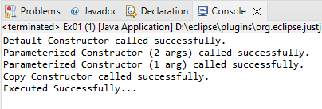
Copy Constructor – How to Use
public static void main(String[] args) {
BankAccount ba01 = new BankAccount(); //default constructor
BankAccount ba02 = new BankAccount(2000.01,0.02); //parameterized constructor
BankAccount ba03 = new BankAccount(99.99); //parameterized constructor
BankAccount ba04 = new BankAccount(ba02); //copy constructor
System.out.println("Executed Successfully...");
}

Slide 19
Why do we need user-defined copy constructors?
In case none is defined, Java does not have any pre-defined copy constructors.
Let’s talk about how java handles references for objects stored in the memory before we continue

Slide 20
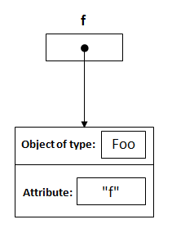
Reference Handling in Java
Foo f = new Foo("f");
Diagrams taken from: https://stackoverflow.com/questions/7893492/is-java-really-passing-objects-by-value
Notes:
https://stackoverflow.com/questions/7893492/is-java-really-passing-objects-by-value

Slide 21
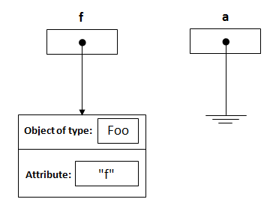
Reference Handling in Java
public static void changeReference(Foo a)
Diagrams taken from: https://stackoverflow.com/questions/7893492/is-java-really-passing-objects-by-value
Notes:
https://stackoverflow.com/questions/7893492/is-java-really-passing-objects-by-value

Slide 22
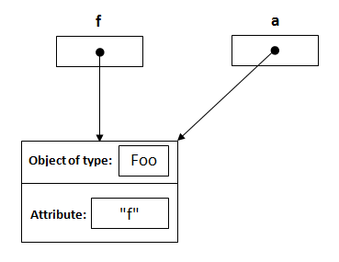
Reference Handling in Java
changeReference(f);
Diagrams taken from: https://stackoverflow.com/questions/7893492/is-java-really-passing-objects-by-value
Notes:
https://stackoverflow.com/questions/7893492/is-java-really-passing-objects-by-value

Slide 23
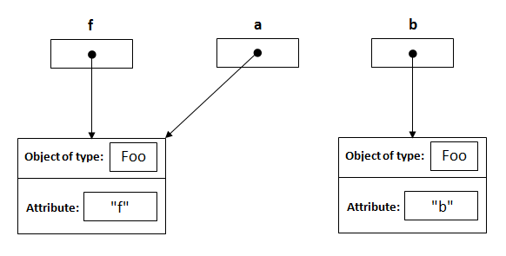
Reference Handling in Java
Foo b = new Foo("b");
Diagrams taken from: https://stackoverflow.com/questions/7893492/is-java-really-passing-objects-by-value
Notes:
https://stackoverflow.com/questions/7893492/is-java-really-passing-objects-by-value

Slide 24
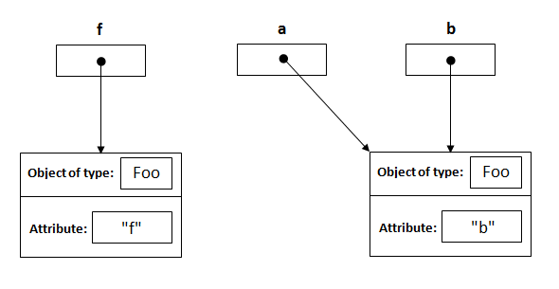
Reference Handling in Java
Foo a = b
Diagrams taken from: https://stackoverflow.com/questions/7893492/is-java-really-passing-objects-by-value
Notes:
https://stackoverflow.com/questions/7893492/is-java-really-passing-objects-by-value

Slide 25
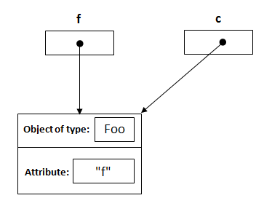
Reference Handling in Java
modifyReference(Foo c)
modifyReference(f)
Diagrams taken from: https://stackoverflow.com/questions/7893492/is-java-really-passing-objects-by-value
Notes:
https://stackoverflow.com/questions/7893492/is-java-really-passing-objects-by-value

Slide 26
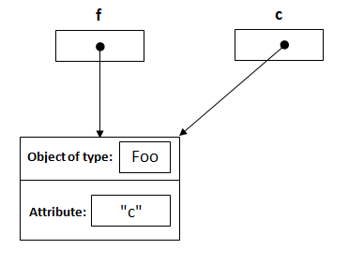
Reference Handling in Java
c.setAttribute("c");
Diagrams taken from: https://stackoverflow.com/questions/7893492/is-java-really-passing-objects-by-value
Notes:
https://stackoverflow.com/questions/7893492/is-java-really-passing-objects-by-value

Slide 27
Shallow Copy | Deep Copy
Shallow Copy:
When you only copy values from one object to another.
Foo a = b in our previous example.

Slide 28
Shallow Copy | Deep Copy
Deep Copy:
Deep copy is possible only with user defined methods or constructors.
In user defined copy constructor, we make sure that copied objects point to new memory locations.

Slide 29
Fin.
: )

